Slide 1
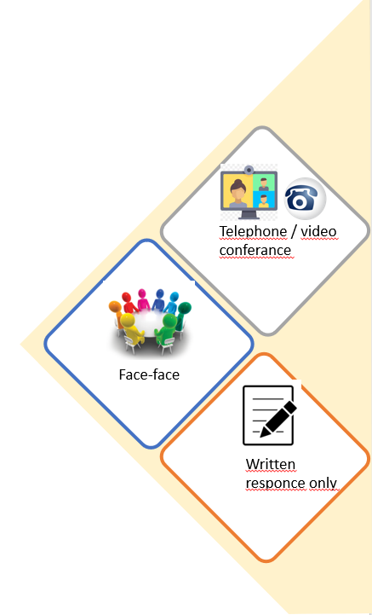
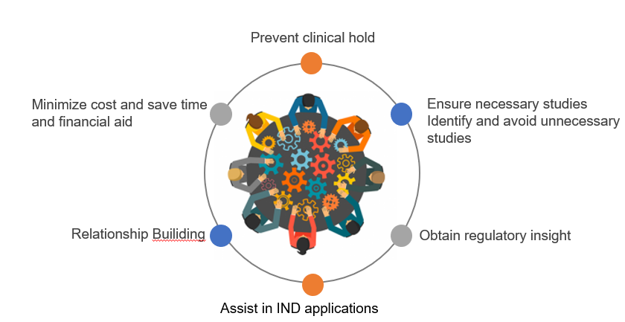
Pre-IND meeting /Scientic advice (SA)
Committee for Medicinal Products for Human Use (CHMP) on the recommendation of the Scientific Advice Working Party (SAWP)
Notes:
very valuable in planning a drug development program,
especially if sponsors' questions are not fully answered by guidances and other information provided by FDA.
Early interactions with FDA staff can help to prevent clinical hold issues from arising.
A pre-IND meeting can also provide sponsors information that will assist them in preparing to submit complete investigational new drug applications.
Efficient use of FDA resources can lead to more efficient drug development.
These questions and answers can be especially helpful to small businesses that may have limited experience interacting with the Agency, or are unfamiliar with pre-IND meetings

Slide 2

Pre-IND meeting /Scientific advice (SA)
Request for scientific advice will be completed using the IRIS platform
Regulatory and procedural guidance on SA - EMA guidance for applicants
Standard operating procedure 01-DEC-15 SOP/H/3037 - EMA regulatory and procedural guidance for scientific advice.
Hertumig EMA Scientific advice document -
Introduction including background information on the disease, the product, regulatory status, and rational for seeking advice.
Notes:
very valuable in planning a drug development program,
especially if sponsors' questions are not fully answered by guidances and other information provided by FDA.
Early interactions with FDA staff can help to prevent clinical hold issues from arising.
A pre-IND meeting can also provide sponsors information that will assist them in preparing to submit complete investigational new drug applications.
Efficient use of FDA resources can lead to more efficient drug development.
These questions and answers can be especially helpful to small businesses that may have limited experience interacting with the Agency, or are unfamiliar with pre-IND meetings

Slide 3

Pre-IND meeting /Scientific advice (SA)
Overview of product development
Quality information, non-clinical information (pharmacology, PK, PD, toxicology), known clinical pharmacology of similar drugs and those predicted for Hertumig (clinical pharmacology, PK, PD, efficacy, and safety).
Questions on quality development
Non-clinical and clinical development, significant benefit, and other CHMP comments.
Notes:
very valuable in planning a drug development program,
especially if sponsors' questions are not fully answered by guidances and other information provided by FDA.
Early interactions with FDA staff can help to prevent clinical hold issues from arising.
A pre-IND meeting can also provide sponsors information that will assist them in preparing to submit complete investigational new drug applications.
Efficient use of FDA resources can lead to more efficient drug development.
These questions and answers can be especially helpful to small businesses that may have limited experience interacting with the Agency, or are unfamiliar with pre-IND meetings

Slide 4
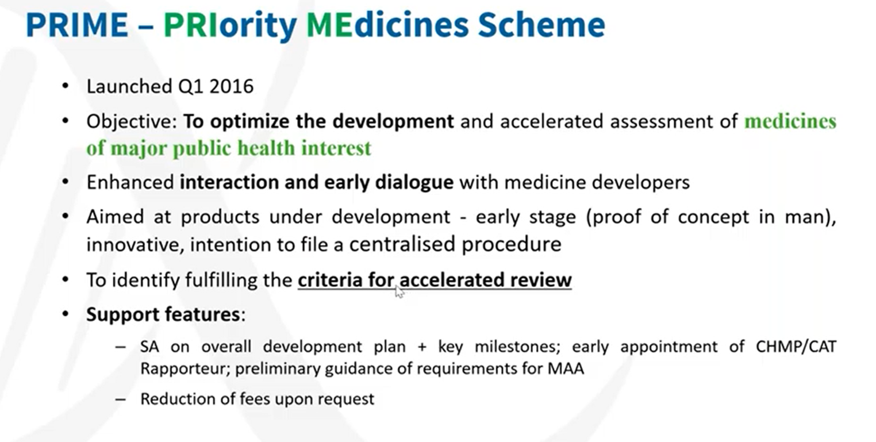

Slide 5
Pre-IND meetings/ Scientific Advice (SA) might be useful presentation script
very valuable in planning a drug development program,
Especially if sponsors' questions are not fully answered by guidances and other information provided by FDA.
Early interactions with FDA staff can help to prevent clinical hold issues from arising.
A pre-IND meeting can also provide sponsors information that will assist them in preparing to submit complete investigational new drug applications.
Efficient use of FDA resources can lead to more efficient drug development.
These questions and answers can be especially helpful to small businesses that may have limited experience interacting with the Agency, or are unfamiliar with pre-IND meetings.
Identifying and avoiding unnecessary studies
Ensuring that necessary studies are designed to provide useful information
Gaining FDA support for a proposed strategy
Potentially minimizing potential for clinical hold
Obtaining regulatory insight
Minimizing costs
Clearly defining endpoints and goals of the development program

